Slide 1
Stewardship
and
Development
Thank you!
Renny Crawford

Slide 2
ADA 2026
Thank you!
-We are at 87 – 90% of Goal
-App. $300,000 ahead of last year
-# of donors is down, $/donation is up
- More than ½ have reached goal
Notes:
Another 10 are within in a week or so…

Slide 3
ADA 2027
Growing Disciples
- What does Growing Disciples look like in your parish?
- I am looking for folks to tell their story
- Focus on growing Participation
Notes:
We had an amazing year last year – 400 people joined the church Easter Weekend!
Focus on the mission that Bishop has led us on – Cultivating Connections, Encountering Christ, Growing Disciples
We need folks to interview
Goal next year is to grow ADA participation.

Slide 4
Clergy Formation
Thank you for promoting & supporting!
Resources page has video links, bulletin/facebook ads
Encourage you to become part of the Social Media…..

Slide 5
End of Year Messages
- $1,000 /$2,000 over standard deduction
- QCD reminder
- Give to 2027 ADA prior to end of year – just need to know
Notes:
New tax law this year -

Slide 6
Housekeeping ….
Gifts of Stock – when using us as pass-through
Gifts of Grain Dmdiocese.org/giving/ways-to-give
- also on Resource page under ADA

Slide 7
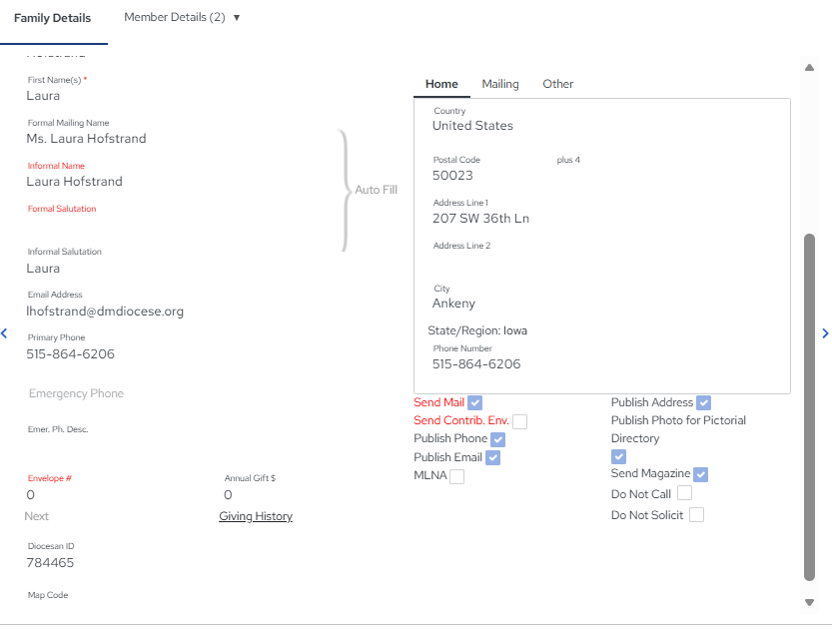
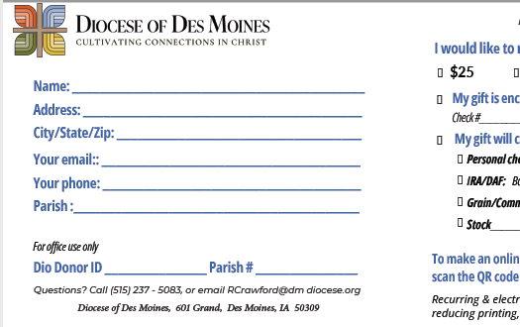

Housekeeping ….
Diocesan ID
Notes:
This is where the Diocesan ID lives in Parish Soft. It goes here on this contribution card.
If you are providing a list of donors included in a check – please include this number.
And now - … Introducing ….

Slide 8
Introducing….
ADA DASHBOARDS

Slide 9

Raiser’s Edge NXT
Raiser’s Edge NXT (RENXT) is the Diocese’s fundraising and donor database.
Information about parishioners, donors, gifts, and pledges is securely maintained.

Slide 10
Raiser’s Edge NXT
Our goal is to give parishes easy access to accurate, up-to-date information.
Dashboards and reports that allow parishes
  monitor ADA progress
  better understand your donors.

Slide 11
Raiser’s Edge NXT
Each parish will have access to information specific to its parish.
You will be able to view donor contact information and ADA giving activity.
One access per parish

Slide 12
Dashboards
Dashboards are an easy-to-read overview of your parish’s fundraising activity.
You can see:
  Number of donors
  Gifts received
  Dollars raised
  Progress toward fundraising goals
  Outstanding pledge

Slide 13
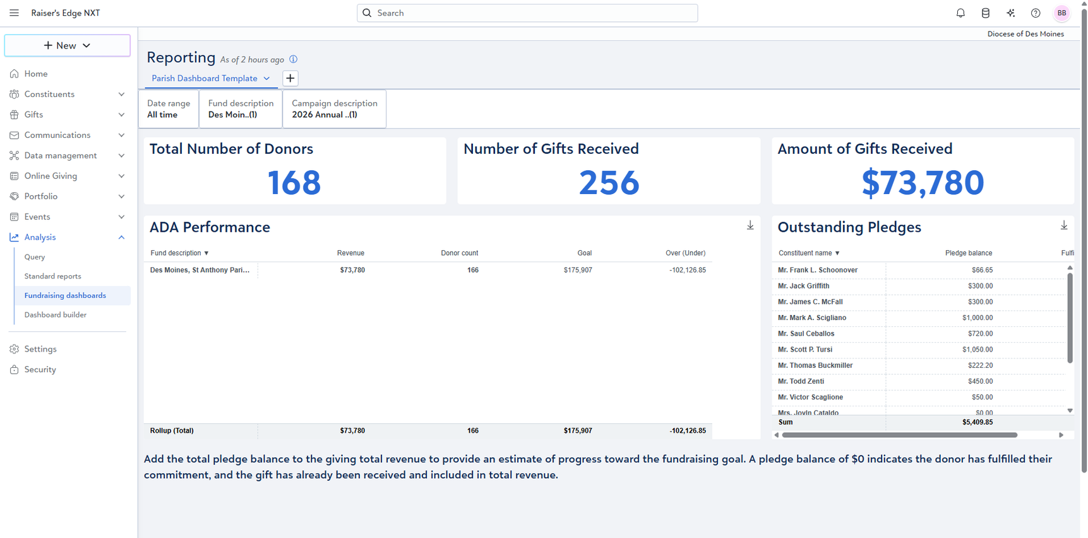
Dashboards
Purpose: The Parish Dashboard provides a quick, current view of your parish’s ADA fundraising activity.
Michael Reynolds
Sarah Bennett
Parish Name
Notes:
This is what your dashboard will look like

Slide 14
Dashboards
Michael Reynolds
Sarah Bennett
Interactive
  Click on totals to see the individual donors or gifts behind the numbers
Export the information
Automatically updated as new gifts are entered at the Diocese.
Monitor your ADA progress.
Parish Name
Notes:
Let’s take a second to break down each of these tables

Slide 15
Single Summary Values
Parish Name
Emily Carter
Michael Reynolds
Sarah Bennett
Daniel Foster
Lauren Mitchell
Christopher Hayes
Megan Sullivan
Andrew Collins
Nicole Harrison

Slide 16
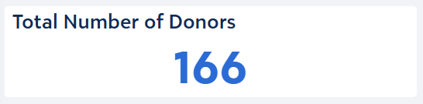
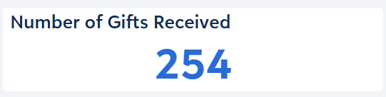
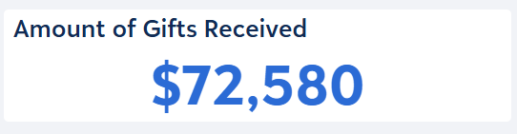
Dashboard Single Summary Values
Total Number of Donors
The number of unique donors who have made a gift to your parish during the current campaign.
Number of Gifts Received
The total number of gifts received by your parish during the current campaign. A single donor may be represented more than once if they made multiple gifts.
Amount of Gifts Received
The total dollar amount of gifts received by your parish during the current campaign.

Slide 17
ADA Performance
Michael Reynolds
Sarah Bennett
Parish Name
Emily Carter
Michael Reynolds
Sarah Bennett
Daniel Foster
Lauren Mitchell
Christopher Hayes
Megan Sullivan
Andrew Collins
Nicole Harrison

Slide 18
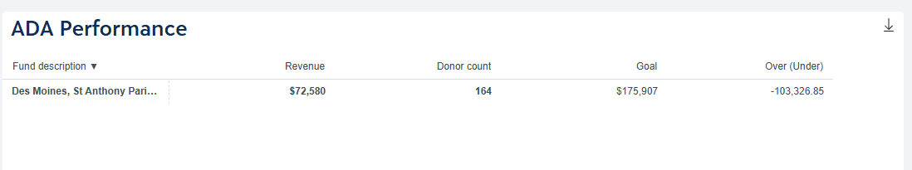
Dashboard Tables
ADA Performance
Summarizes your parish’s ADA performance, including revenue received, donor count, annual goal, and the amount currently over or under goal.
Parish Name

Slide 19
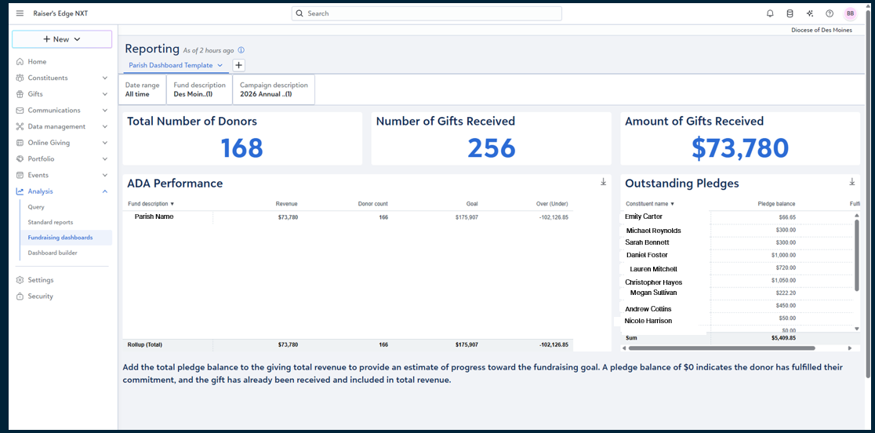
Dashboard Tables

Slide 20
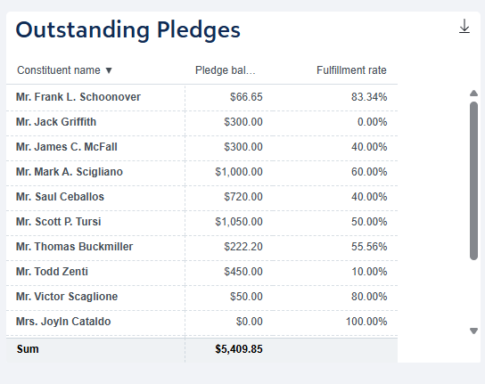
Dashboard Tables
Outstanding Pledges
Lists donors who still have an unpaid pledge balance.
A $0 pledge balance indicates that the commitment has been fully paid
Received amount is already included in total revenue.
Frodo Baggins
Samwise Gamgee
Bilbo Baggins
Peregrin Took
Edmund Pevensie
Lucy Pevensie
Mrs. B. Beaver
Mr. Tummus
Mr. Reepicheep
Aslan The Great

Slide 21
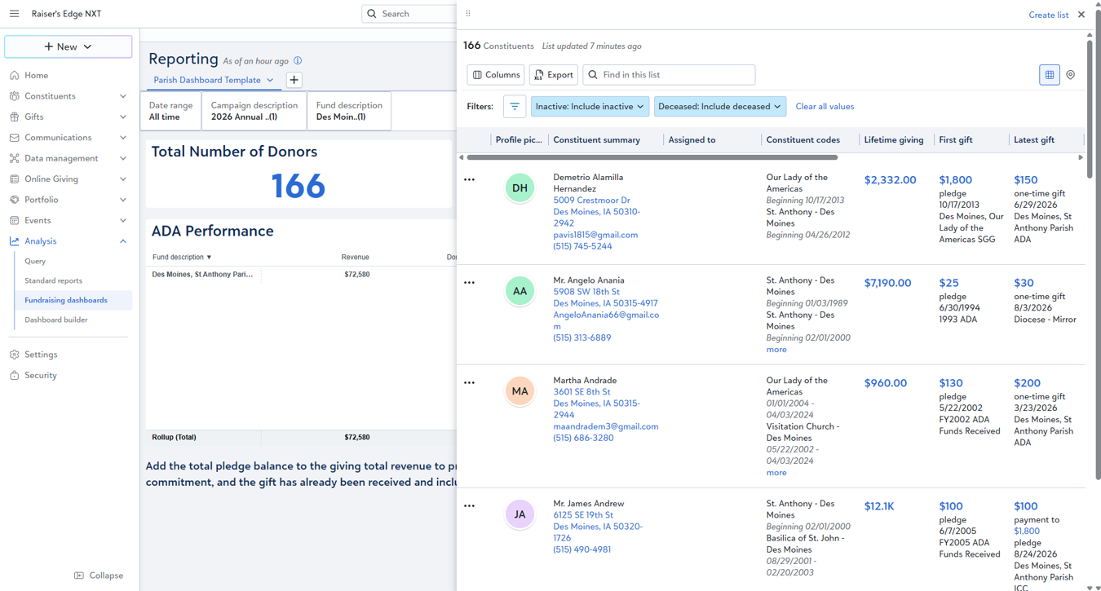
Features & Tools
  Dashboard values and tables are interactive.
  Clicking a value, such as Total Number of Donors, opens the underlying constituent or gift records included in that result.
  From the resulting list, you can review additional details and export the data to Excel when needed.
  The dashboard is dynamic
  It will reflect the most current information available in Raiser’s Edge NXT.
  As gifts and pledge payments are entered, the dashboard updates automatically.
Mr. Bilbo Baggins
Bag End
1 Bagshot Row
Hobbiton, Shire 12345
onering@hillshire.net
Mr. Frodo Baggins
Bag End
1 Bagshot Row
Hobbiton, Shire 12345
onering@hillshire.net
Mr. Samwise Gamgee
Bag End
6 Bagshot Row
Hobbiton, Shire 12345
Loyalcomp@hillshire.net
Mr. and Mrs. Build Beaver
#1 Beaversdam
Great River, Narnia 9876
busybeaver@narnia.net

Slide 22
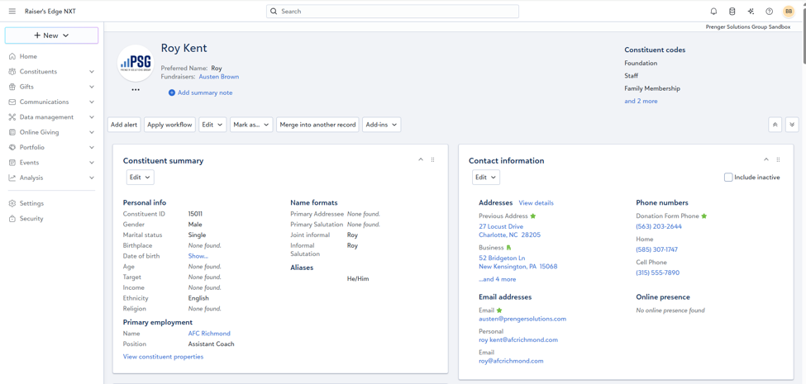
Viewing a Donor/Parishioner Record
Once you locate and open a donor or parishioner record, you can review the contact and giving information available to your parish.
Contact Information
The Contact information section displays available addresses, phone numbers, and email addresses for the constituent.

Slide 23
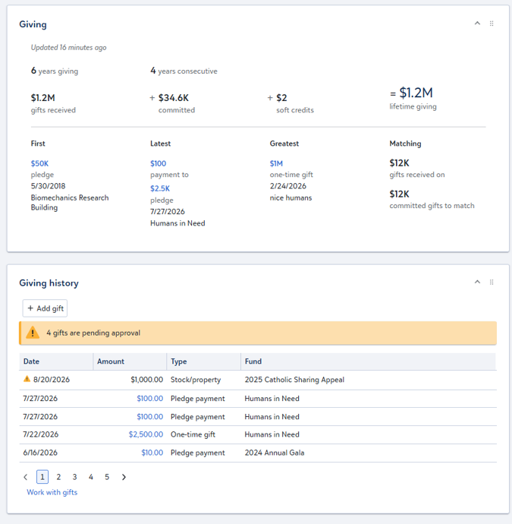
Viewing a Donor/Parishioner Record
Giving Information
The Giving section provides a summary of the constituent’s giving to your parish
  key giving totals
  gift history.
Use the gift history to
  review individual transactions
  the summary at the top for a quick overview of the donor’s giving.
Narnia ADA
Narnia Restoration Projecta

Slide 24
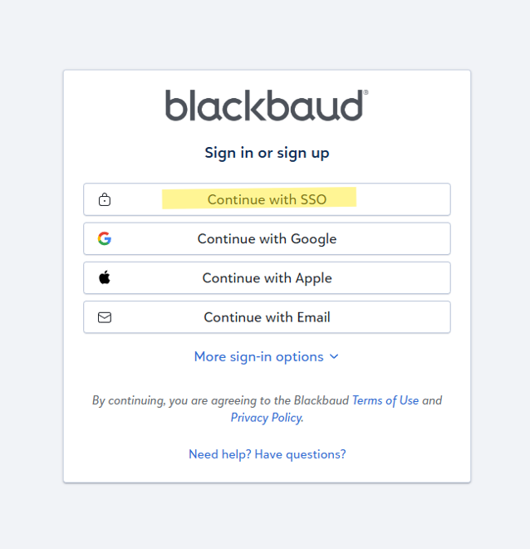
Logging In to Raiser’s Edge NXT
  Go to the Raiser’s Edge NXT sign-in page: app.blackbaud.com/signin/
  Select Continue with SSO.
  Enter your username and password.
  Complete multi-factor authentication, if prompted

Slide 25
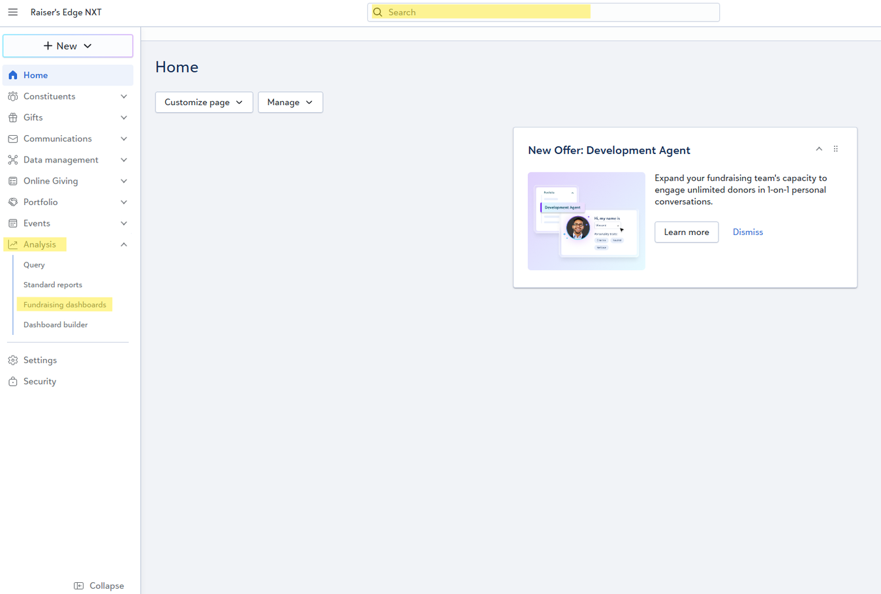
Navigating Raiser’s Edge NXT
Accessing Dashboards
After you sign in, you will land on the Raiser’s Edge NXT home page. From the menu on the left side of the screen, select Analysis.
Under Analysis, select Fundraising dashboards. This opens the dashboard/report created specifically for your parish.
Search for a donor or Parishioner:
To look up a donor or parishioner, use the Search bar at the top of the screen. You can search using available biographical information, including the person’s name, address, phone number, or email address.

Slide 26
Stewardship
and
Development
Thank you!
Renny Crawford

